Slide 1
Nuclear Fission

Slide 2
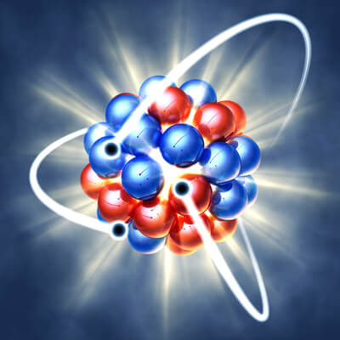
In this Smart Lesson you will learn to:
Define nuclear fission.
Explain a neutron-induced nuclear fission reaction, including references to extra neutrons produced from many of these reactions.
Explain a fission chain reaction.

Slide 3
Nuclear fission is the process of splitting the atom.
It is defined as the process in which a large unstable nucleus splits, forming two (or more) smaller, more stable nuclei and releasing neutrons and energy.
A large, unstable atom absorbs a neutron, which causes it to split into two smaller nuclei. These two fission fragments are much more stable than the original nucleus.

Slide 4
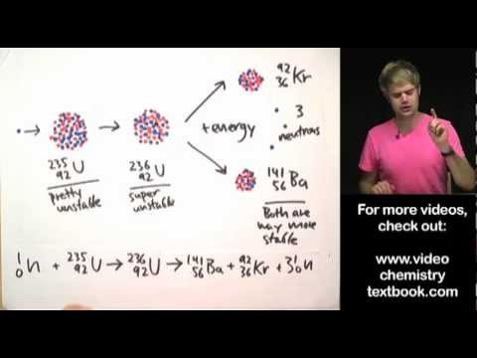

Slide 5
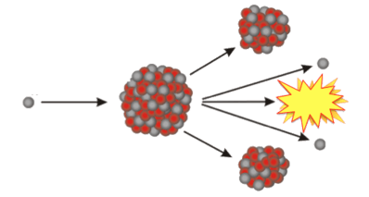
Let's look at an example:
Uranium-235 absorbs a slow neutron to form uranium-236, which is extremely unstable. It immediately decays into two smaller fission fragments.
Two or three fast neutrons and energy are also produced in this reaction.

Slide 6
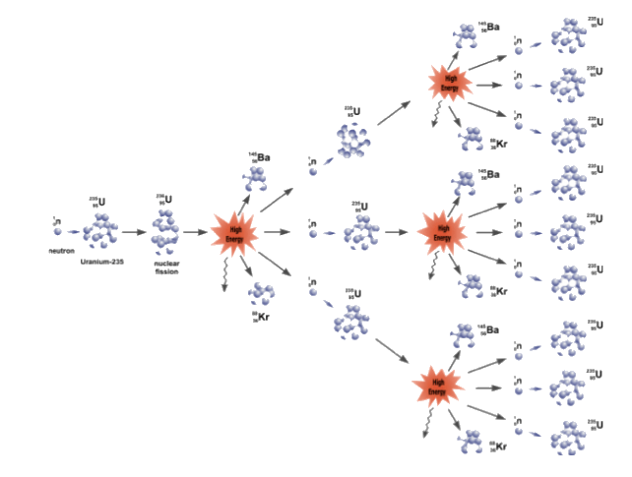
Fission chain reactions.
Chain reactions occur when the neutrons produced in one fission reaction strike another unstable nucleus, inducing another fission reaction.

Slide 7
Chain reactions can be controlled or uncontrolled.
Controlled reactions are used in nuclear power plants because they sustain the original effect. Uncontrolled reactions are used in nuclear bombs because they magnify the original effect.
This diagram shows an uncontrolled reaction.

Slide 8
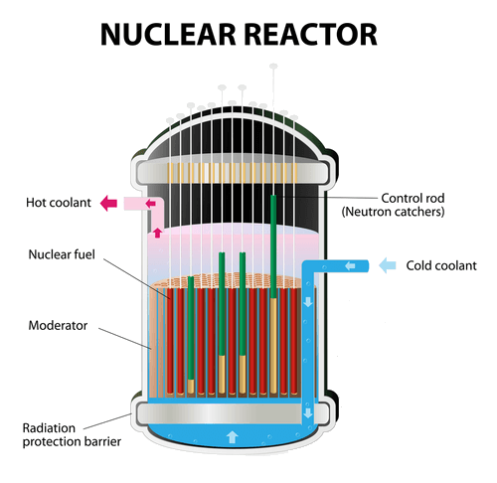
So how is a fission chain reaction controlled?
As the neutrons are released from the fission of a nucleus, they must be absorbed and not allowed to split more atoms.
In this way, the rate of splitting the atoms and energy released is controlled.

Slide 9
So which atoms are used in fission reactions?
Any fissionable nuclide can under go nuclear fission after absorbing a neutron. We mentioned uranium-235 before, but there are some other fissionable nuclides, although they are uncommon.
Uranium-235 and plutonium-239 are both fissionable. A slow neutron (low energy) can induce nuclear fission with these atoms. Atoms that only require slow neutrons to split are described as fissile.
Uranium-238 is only slightly fissionable. It requires a fast neutron (high energy) to undergo nuclear fission.

